Slide 1
Route Optimization
Based On Crowd Sourced Data
Use Case Diagram
Group Members:
1405009
1405013
1405014
1405015
1405016

Slide 2
We divided our whole system into 3 subsystems:
Registration/LogIn Subsystem
Traffic Update Subsystem
Route Proposal Subsystem

Slide 3
Registration/LogIn Subsystem
Use – Case | Actor(s)
Log Out | User, Media
Register Now | User, Media
Log In | User, Media
Restore Password | User, Media

Slide 4
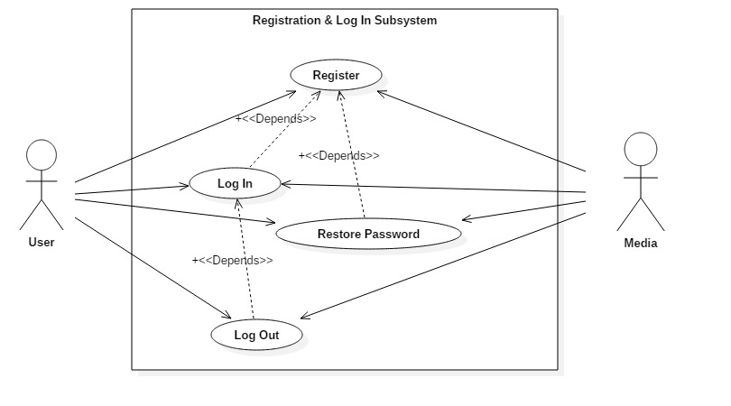

Slide 5
Use Case Narrative For Registration
Use Case Name: Registration
Priority: Medium
Primary Actor: User, Media
Trigger: User touches the button register
Precondition: Inserts new mail address, mail address must exist and can’t have been used before

Slide 6
Use Case Narrative For Registration
Typical Course of Event
User | System Response
 | 1.System shows registration pages after this action is triggered
 | 2.System asks user to fill up the page
3.User provides Data | 4.Check if data has been provided correctly
 | 5.Asks for E-Mail verification
6.User verifies E-Mail and completes registration process

Slide 7
Use Case Narrative For Registration
Alternate Course of Event
User | System Response
1.User does not provide all required data or password does not maintain minimum requirement | 2.System shows error message and asks user to follow procedure correctly

Slide 8
Use Case Narrative for Registration
Post Condition: New user data is stored in the database
Conclusion: Concludes when user verifies email

Slide 9
2. Traffic Update Subsystem
Use-Case | Actor(s)
Update | User, Media, Admin
Undo | User, Media, Admin

Slide 10
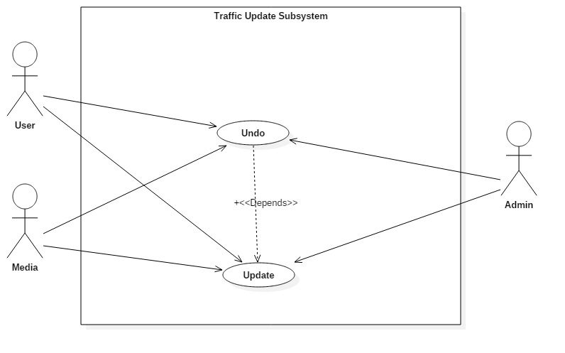

Slide 11
Use Case Narrative for Update
Use Case Name: Update
Priority: High
Primary Actor: User, Media, Admin
Trigger: User touches update button
Precondition: User is registered and logged in

Slide 12
Use Case Narrative for Update
Typical Course of Events:
User | System Response
 | 1.System shows a map. On the upper side a viewfinder map is shown and in main screen a zoomed map is shown at current location
 | 2.System gets user location from GPS data or it is provided by user
 | 3.System shows nearby roads
4.User provides data (direction and jam severity) | 5.System stores data for future use

Slide 13
Use Case Narrative for Update
Post Condition: Data is stored in central database
Conclusion: Ends when user touches “Confirm” button or “Home” button

Slide 14
3. Route Proposal Subsystem
Use-Case | Actor(s)
Get Direction | User
Set Destination | User
Set Starting Point(Optional) | User
Change Starting Point | User

Slide 15
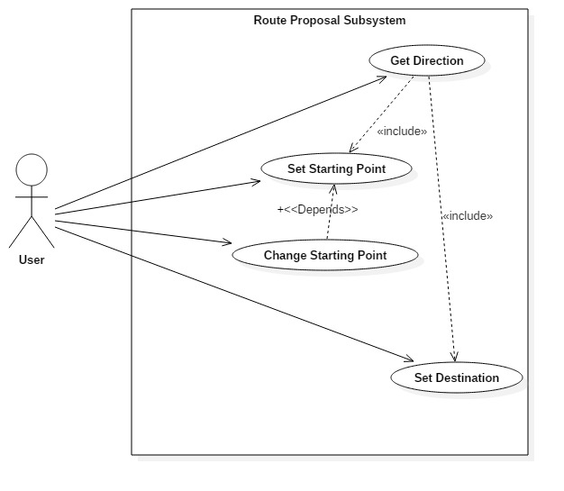

Slide 16
Use Case Narrative for Get Direction
Use Case Name: Get Direction
Priority: High
Primary Actor: User
Trigger: User touches “Get Direction” button
Precondition: User has enough coin

Slide 17
Use Case Narrative for Get Direction
Typical Course of Events:
User | System Response
 | 1.System asks for starting point or gets it from GPS
2.User provides starting point | 3.System asks for destination point
4.User Provides Destination | 5.System does necessary calculations and shows optimized route

Slide 18
Use Case Narrative for Get Direction
Post Condition: Optimized route is provided to the user
Conclusion: Screen returns to home after showing optimized route

Slide 19
Thank You

